Slide 1

Product Data Challenge
Thanksgiving sales trends

Slide 2
Introduction to the problem
The challenge poses a number of analysis questions, which can only be achieved if we have comprehensive product data.
Sales data has complete item names.
The Google Product Taxonomy data maps onto the sales data.
But roughly 68% of the sales data still has a missing category after mapping.
The challenge is to find a way to classify these items into categories using an appropriate data science approach.

Slide 3
Matching items to categories
Found that some items are mapped to multiple different categories
First step was to decide on an approach for determining which category each item belonged to, in cases where there were multiple categories assigned to an item.
I made use of a simple fuzzy matching process using the `fuzzywuzzy` Python library. Simple string matching.
This worked to pick a definitive category per item, but I also realised that any future classification model that I create would also be able to classify these definitively as well.

Slide 4
Framing the classification problem
Identified that we could approach this as a classification problem, where we would use the item names to predict the product categories.
Target variables are complex, and contain a hierarchy i.e., Apparel > Loose > Bottoms > Jeans.
Followed a hierarchical classification approach.
Trained a local classifier per node in each target variable hierarchy, using the `hiclass` library in Python.
An alternative approach would be to flatten the category (multi-class classification).

Slide 5
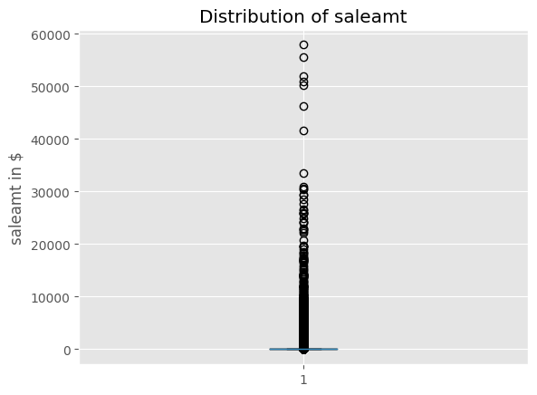
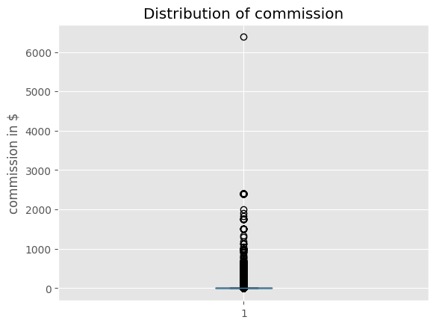
Exploratory data analysis
PageOne Lighting Skylight LED Round Flushmount
Saleamt of $33.5k, and commission of $6,380 (online search shows the average price is $250)
Could be a legitimate transaction, although if multiple items were purchased assume they would take the form of multiple transactions

Slide 6
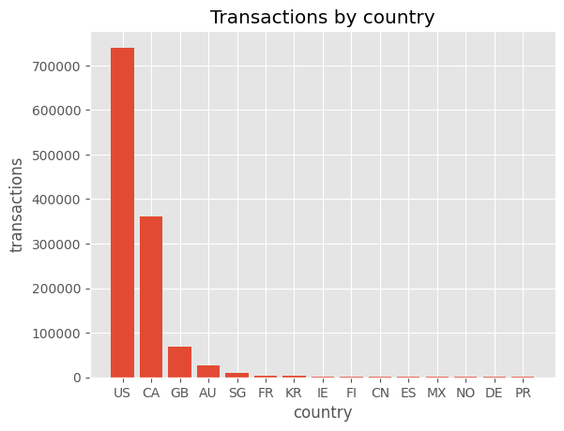
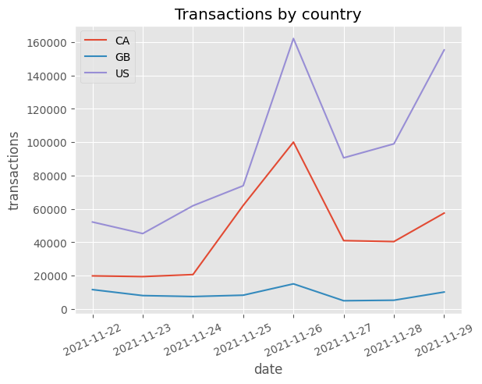
Exploratory data analysis

Slide 7
Feature engineering
Made the decision to only use the item name as a feature, as the other sales information might not be too informative.
Subset sales data to only use completed categories (labels) for training and testing purposes.
Text processing:
Removing special characters, numbers, punctuation
Tokenize the text
Remove stop words i.e., ‘and’, ‘the’
Rejoin words into cleaned sentence

Slide 8
Target variable
Processed the target variables as they looked like this initially:
'Apparel > Loose > Bottoms > Jeans'
While they needed to be in this form for training:
['Apparel', 'Loose', 'Bottoms', 'Jeans']

Slide 9
Vectorizing text data
Text classification models require that we convert text data into numerical form.
Used a CountVectorizer to convert the text data into an array/matrix of token counts.
Each token occupies a position in the output matrix.
The number of times that the token appears in any given text is the number stored in its respective position in the matrix.
Due to resource constraints, limited the output matrix to the top 300 tokens, which needed to occur in at least 5 different item names.

Slide 10
TF-IDF
Term-frequency times inverse document-frequency.
Works well in text classification.
Uses the frequency of the tokens to determine how relevant they are to a given document (item name).
TF = frequency of token in document.
IDF = how common a token is across a corpus.
Applied post the CountVectorizer.
Results in a sparse matrix.

Slide 11
Model training
Train/test split of 80/20%.
Tried many libraries but settled on the `hiclass` approach.
Attempted to use bert-sklearn but took too long to train.
Chose a simple base classifier (RandomForestClassifier) and used this within the hierarchical model class.

Slide 12
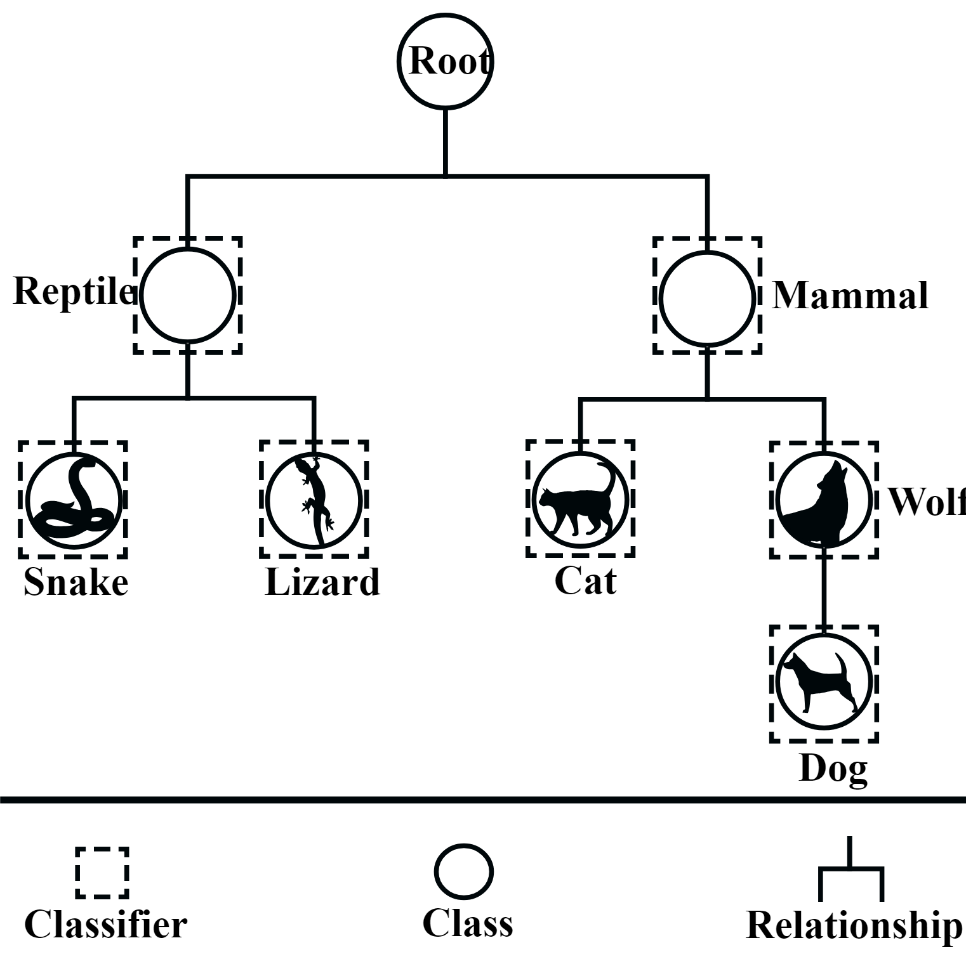
Model training
Local Classifier Per Node
Classifier trained per node
Predictions made for each node
Aggregated

Slide 13
Model evaluation
Evaluated the model using typical classification metrics that have been adjusted to assess hierarchical problems.
Used these metrics because the problem is both multiclass and has a hierarchical component.
F1-score: 85.7%
Precision: 79.4%
Recall: 93.2%

Slide 14
Model inference
Predictions were generated for all of the items in the original sales data.
These predicted categories would now become the basis for answering the product data questions that were posed.
Running inference in a large batch does not work well on a large laptop (64GB ram, i9 processor). Not able to leverage GPU.
Instead inference was performed in smaller batches of 1000 records.

Slide 15
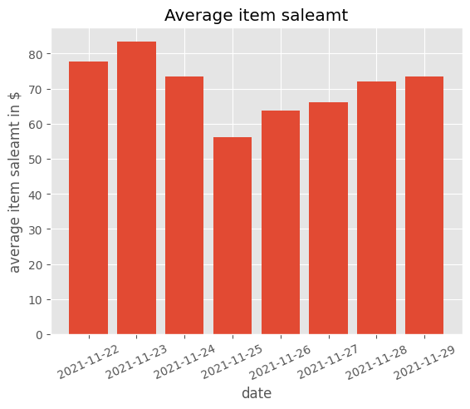
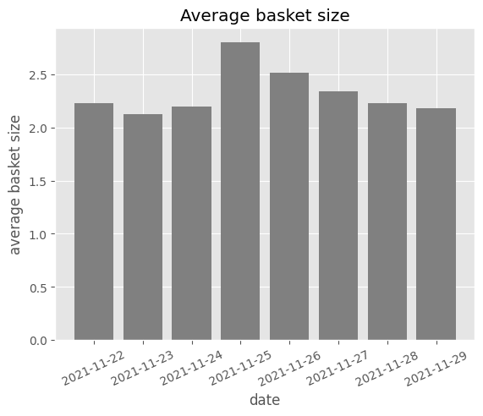
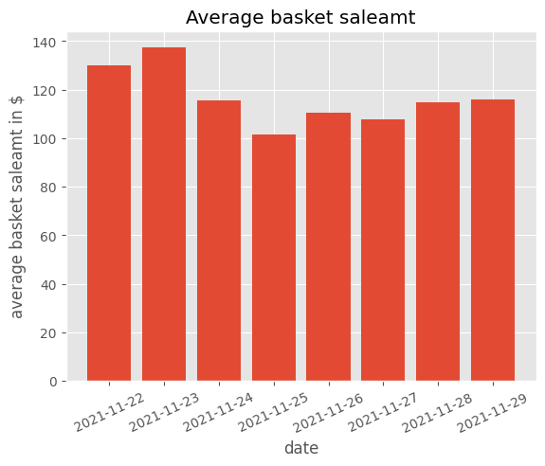
Q1: What product sales trends do you observe from the data during Thanksgiving holidays in 2021?
Transactions: Black Friday (26) > Cyber Monday (29) > Thanksgiving (25)
Country: US largest (then CA, GB), CA had a big jump on Thanksgiving and Black Friday
Cheaper items ($56) and larger basket sizes (~3) on Thanksgiving
Smaller basket sizes (~2) on Cyber Monday

Slide 16
Q2: What are the top selling products during Thanksgiving week 2021, overall and by product category?
Oversized Vintage Tunic Sweatshirt for Women | 3,255
Printed Flannel Pajama Pants for Men | 3,054
High-Waisted Jersey Ankle Leggings For Women | 2,794
Theragun Elite Black - Smart Percussive Therapy Massager | 2,697
Soft-Washed Crew-Neck T-Shirt for Men | 2,580

Slide 17
Q2: What are the top selling products during Thanksgiving week 2021, overall and by product category?
Apparel & Accessories > Clothing > Pants > Jeans | 258,451
Apparel & Accessories > Clothing > Shirts & Tops > T-Shirts | 169,883
Vehicles & Parts > Vehicle Parts & Accessories > Motor Vehicle Parts > Motor Vehicle Suspension Parts | 152,070
Apparel & Accessories > Shoes > Athletic Shoes & Sneakers > Sneakers | 113,527
Apparel & Accessories > Jewelry > Charms & Pendants | 87,867

Slide 18
Q3: What are the highest commissioned product items?
PageOne Lighting Skylight LED Round Flushmount Light | $6380.35
Mater High Stool - Premium Edition | $1910.32
Serge Mouille Three Arm Multi-Light Pendant Light | $1329.05
Brando 74" Leather Sofa | $1294.56
1.7 Carat, Super Ideal Cut, D Color, VVS1 clarity Round Diamond | $1179.00

Slide 19
Q3: What are the highest commissioned product items? With cards.
The Business Platinum Card® from American Express | $187,300.00
American Express Blue Business Cash™ Card | $179,215.00
Theragun Elite Black - Smart Percussive Therapy Massager | $112,924.98
The Blue Business® Plus Credit Card from American Express | $49,175.00
American Express® Business Gold Card | $29,050.00

Slide 20
Q3: What are the highest commissioned product items? Without cards.
Theragun Elite Black - Smart Percussive Therapy Massager | $112,924.98
Bowflex C6 Bike | $21,745.17
Theragun Elite White - Smart Percussive Therapy Massager | $20,165.46
Sony PS5 PlayStation 5 (US Plug) Blu-ray Edition Console 3005718 White | $15,162.46
Bowflex Max Trainer M6 | $11,626.86

Slide 21
Q4: Which product items are frequently purchased together during Thanksgiving?
High-Waisted Pixie Ankle Pants for Women
High-Waisted Pixie Straight-Leg Ankle Pants for Women, 3432
Oversized Vintage Tunic Sweatshirt for Women
Vintage Long-Sleeve Garment-Dyed French-Terry Tunic Sweatshirt for Women, 2856
High-Waisted Pixie Ankle Pants for Women
High-Waisted Pixie Full-Length Pants for Women, 1680
High-Waisted Jersey Ankle Leggings For Women
High-Waisted Rib-Knit Leggings For Women, 1540
Unisex Licensed Graphic Bodysuit for Baby
Unisex Licensed Pop-Culture Graphic Bodysuit for Baby, 1296

Slide 22
Q5: Which product categories are most frequently purchased together during Thanksgiving?
Apparel & Accessories > Clothing > Pants > Jeans
Apparel & Accessories > Clothing > Shirts & Tops > T-Shirts, 196961
Apparel & Accessories > Clothing > Pants > Jeans
Apparel & Accessories > Shoes > Athletic Shoes & Sneakers > Sneakers, 94346
Apparel & Accessories > Clothing > Shirts & Tops > T-Shirts
Apparel & Accessories > Shoes > Athletic Shoes & Sneakers > Sneakers, 81766
Apparel & Accessories > Clothing > Pants > Jeans
Apparel & Accessories > Jewelry > Charms & Pendants, 71005
Apparel & Accessories > Clothing > Shirts & Tops > Polo Shirts
Apparel & Accessories > Clothing > Shirts & Tops > T-Shirts, 51466

Slide 23
Q6: How were product sales trends similar or different between Black Friday and Cyber Monday?
Overall
Theragun the top seller (revenue) for both days
Theragun the top sold (units) for Cyber Monday, but not for Black Friday (that was pajama pants for men)
Units
Leggings and T-shirts on Black Friday
Backpacks and jeans did well on Cyber Monday
Revenue
Cyber Monday seems to see more electronics being sold (two types of PS5 and Xbox)
Air Jordans did well for both, but different variants sold
Dyson hair dryer and Pixel phone did well on Black Friday (didn’t feature on CM)

Slide 24
Q7: What business recommendations can you provide based on the above analysis?
Fitness products are popular. Perhaps find ways to encourage purchasing items adjacent to these top sellers (add-ons).
There seems to be a focus on slightly cheaper items but larger baskets for Black Friday compared with Cyber Monday. Maybe survey customers to find out more about psychological perceptions of each.
If more gaming consoles are bought on Cyber Monday, then adjust pricing strategies accordingly.
Black Friday is bigger from a volume perspective. Perhaps consumers exhaust their finances then. Investigate strategies to spread the spending out.
Understand the buying behavior of fitness consumers i.e., more resistant to perceived overspending from Black Friday? They bought a lot on Cyber Monday.

Slide 25
Q8: We want to deploy the analysis as a client facing feature, what do you envision the deployment to look like?
Classifications or analysis/recommendations?
Either would still require the category classification model, therefore we’ll start with that solution.

Slide 26

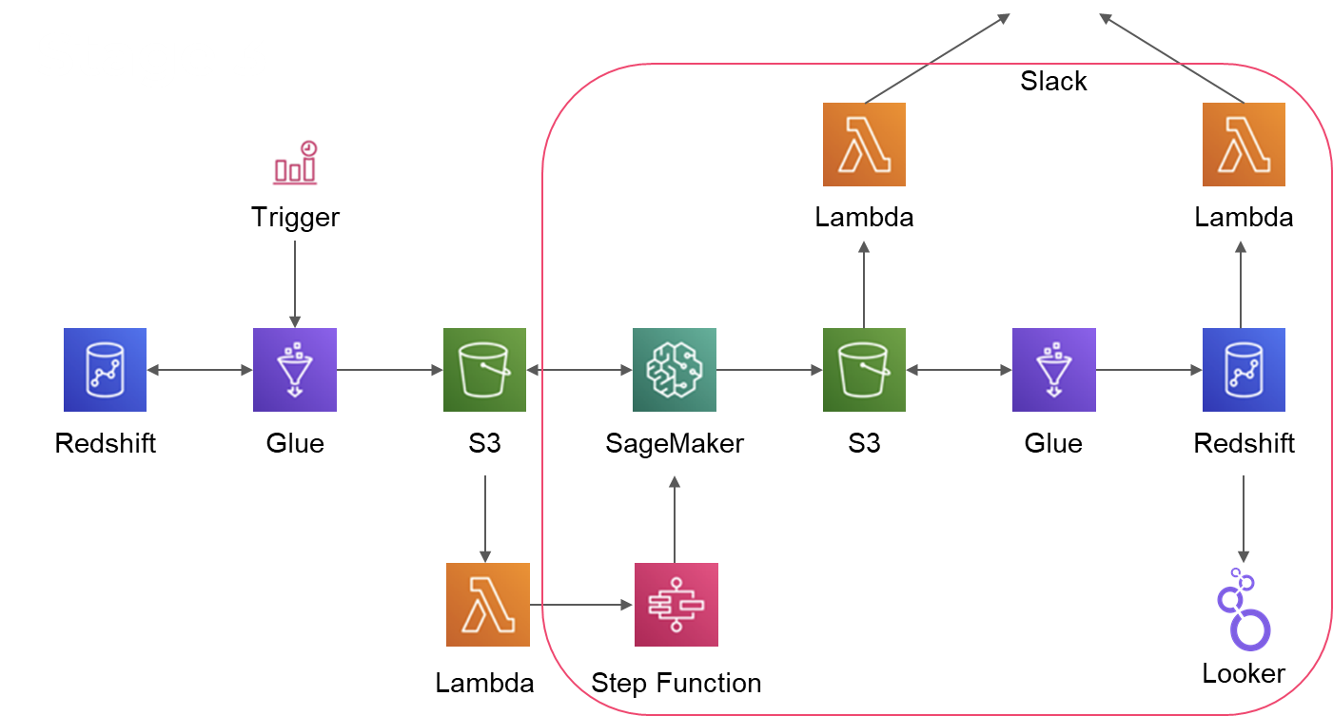
Model deployment solution

Slide 27
Recommendations deployment solution
Could take the form of an optimizer, to assist companies in the following ways:
Allocate items to sales days depending on the types of items being sold on historical sales days.
Recommendations for discounts based on previous discounts and how they performed.
The recommendations would leverage the classifications made by the category classifier.
The analysis i.e., computing the required measures for the purposes of populating the recommendations could also be executed in a SQL or Python environment.
This could occur in the same environment as the classifier, but after it runs.

Slide 28
Ideas for further improvement
Spend more time understanding the nuances of the data i.e., remove outliers, credit card items etc.
Consider using pre-trained word embeddings, or other more powerful NLP approaches.
Use a Keras, TensorFlow or PyTorch implementation that can train on a GPU. This may given better performance, faster to train, faster inference, easier to work with classification layer mechanism.
Look at including other features to augment the item name feature.
Model interpretation, feature importance (SHAP).
Spend more time understanding how other companies (Spotify) have solved such problems.

